Slide 1
Digital portfolio
STUDENT NAME:MUSFIRA K F
REGISTER NUMBER:34624U09060
NM ID:astvu346m24340
DEPARTMENT:BCA(BACHEOLARS OF COMPUTER APPLICATION)
COLLEGE:MMES WOMENS ARTS AND SCIENCE COLLEGE

Slide 2

PORTFOLIO WEBSITE MY DIGITAL PORTFOLIO

Slide 3
AGENDA
Problem statement
Project overview
End users
Tool and Technologies
Portfolio design and layout
Features and Functionality
Results and Screenshot
Conclusion
Git hub Link

Slide 4
PROBLEM STATEMENT
Traditional resumes are static and less interactive.
Student need a modern, attractive portfolio to showcase skills.
Aim: Build a personal website that highlights project, skills, and achievements.

Slide 5
PROJECT OVERVIEW
A portfolio website created with HTML, CSS, and Java script.
Include sections : About me, skills, projects, contact.
Design with a dark pastel theme and animations for engagement.

Slide 6
END USERS
Recruiters->View skills and projects.
Clients->Check web development and hacking expertise.
Peers/students->Learn and collaborate.
Myself->To showcase career progress.

Slide 7
TOOLS AND TECHNOLOGIES
Frontend:HTML5, CSS3, Java script.
Version control : Git hub.
Design : Responsive layout, animations, pastel colors.

Slide 8
PORTFOLIO DESIGN AND LAYOUT
Sticky header with navigation.
Hero section with typing effect.
About section(intro + goals).
Skills with animated progress bars.
Projects grid with images & hover effects.
Contact form with name, email, & message

Slide 9
6.FEATURES AND FUNCTIONALITY
Typing animations in hero sections.
Animation skill bars on scroll.
Hover effects on projects.
Full responsive for all devices.
Interactive contact form.

Slide 10
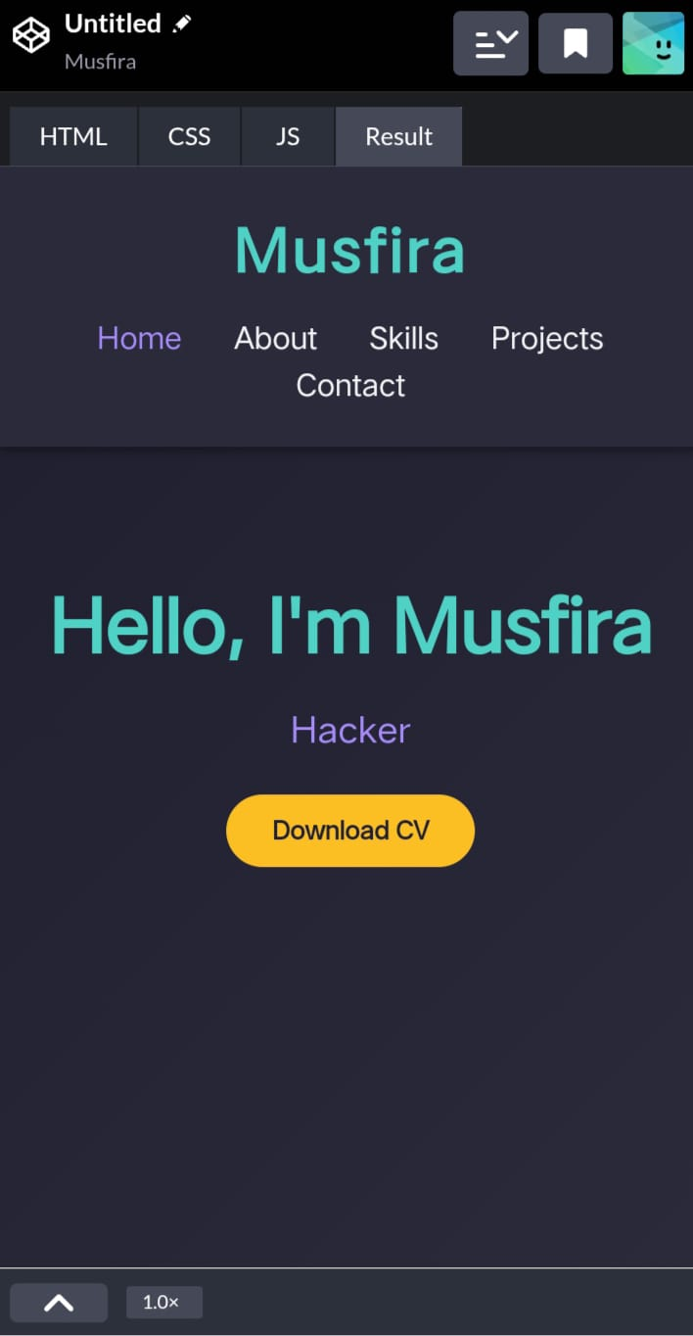
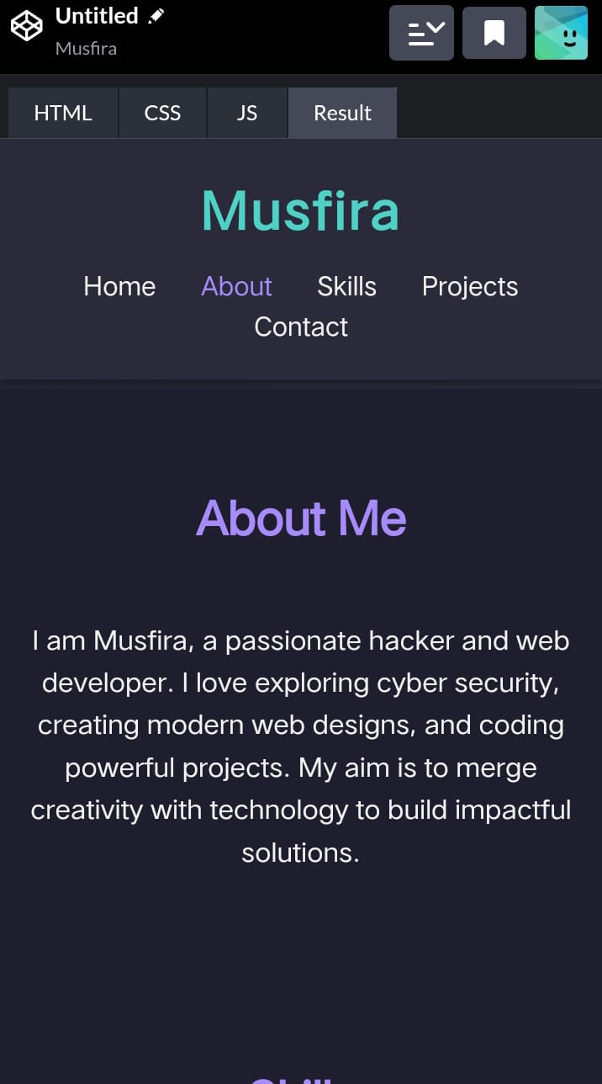
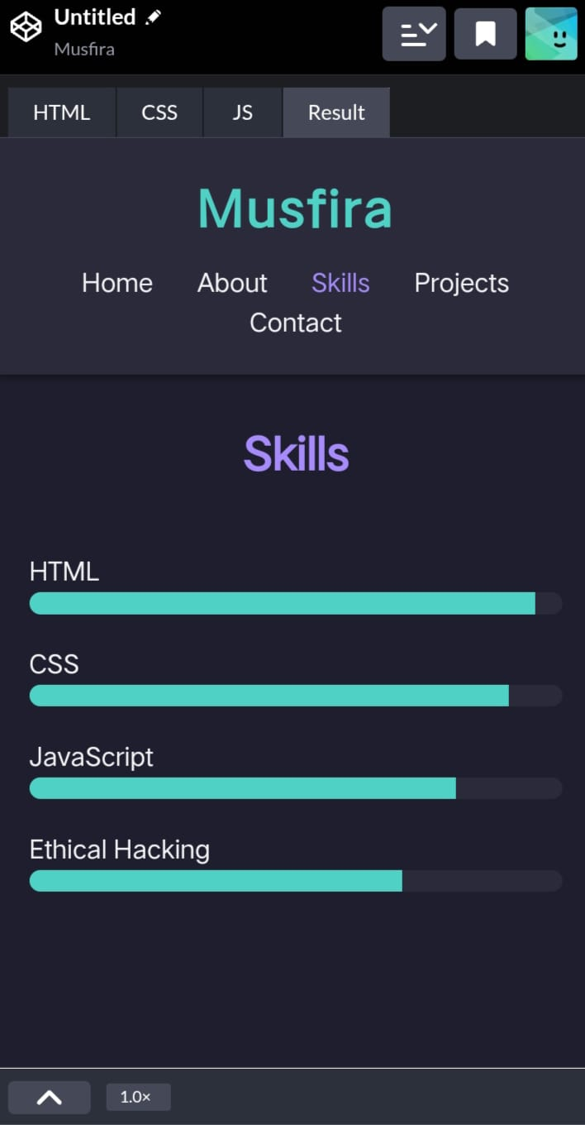
SCREENSHOT AND PDF IMAGE

Slide 11
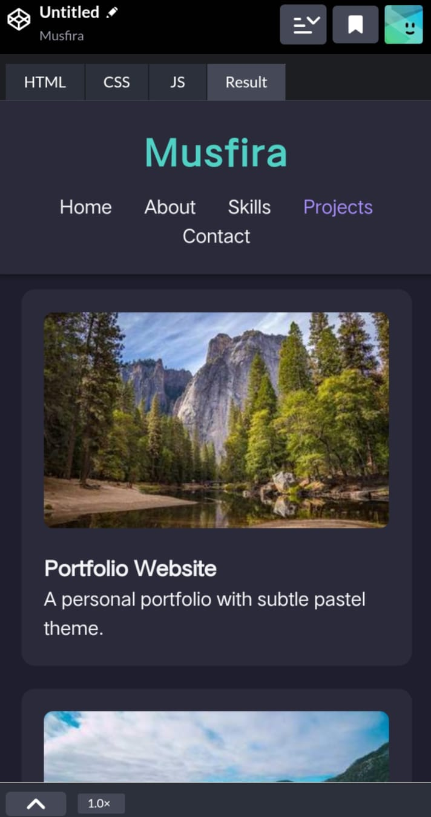
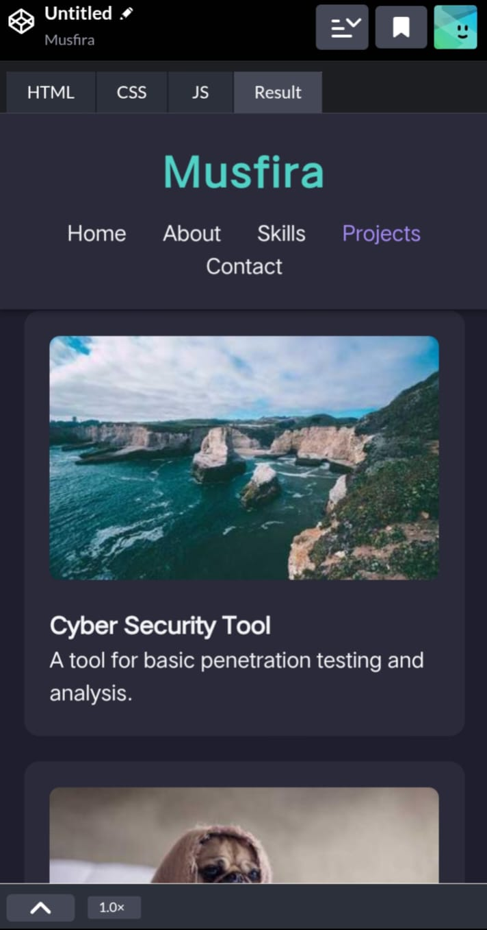
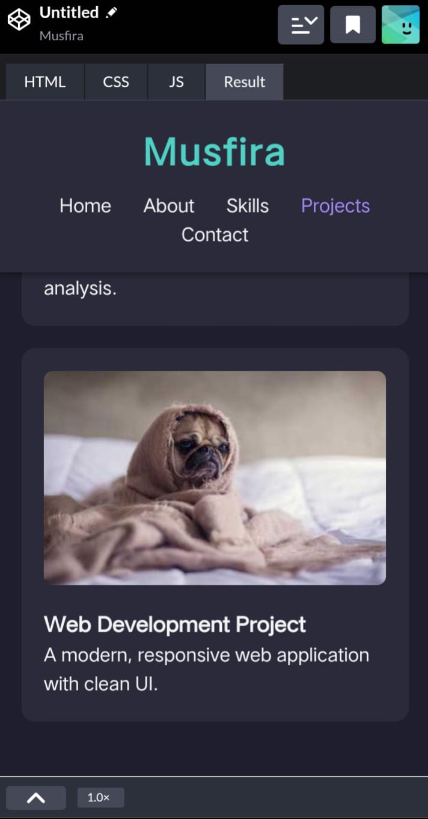
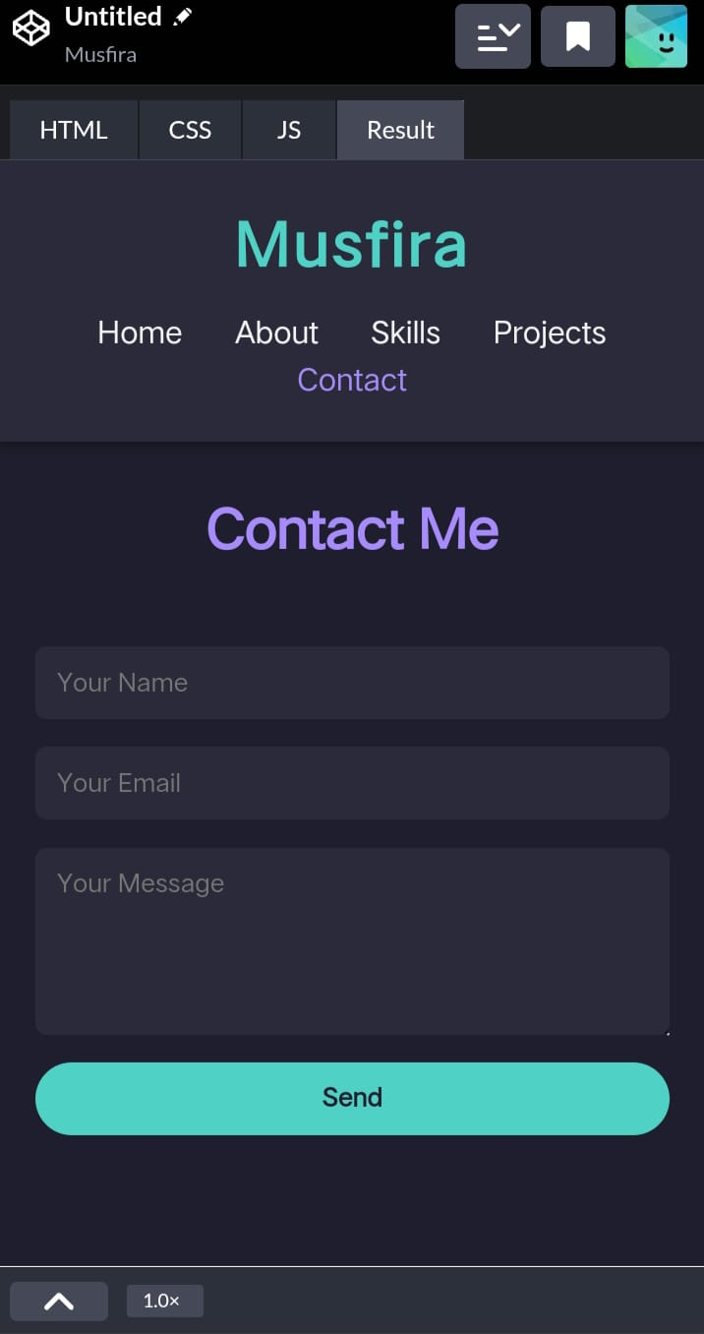

Slide 12
CONCLUSION
A modern, interactive portfolio to represent me digitally.
Highlights my skills in hacking, coding and web development.
Makes it easier for recruiters and clients to connect with me.
Git hub Link :https://musfirasam47-spec.github.io/Musfiras-portfolio./

